Slide 1
Keep America Beautiful
Brendan Nash

Slide 3
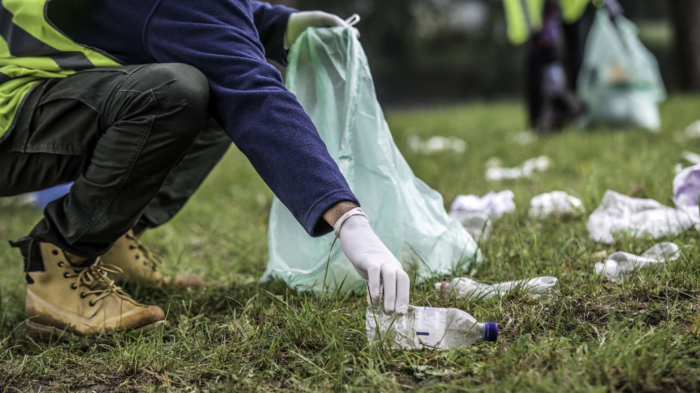
Keep America Beautiful
Founded in 1953
Provides Expertise, programs, and resources to help people end littering, improve recycling, beautify America’s public Spaces, and restore & support resilient communities.
5 values: Trust & Respect, Creative Drive, Positive Attitude, Collaborative Accountability, and Courageous Authenticity

Slide 4
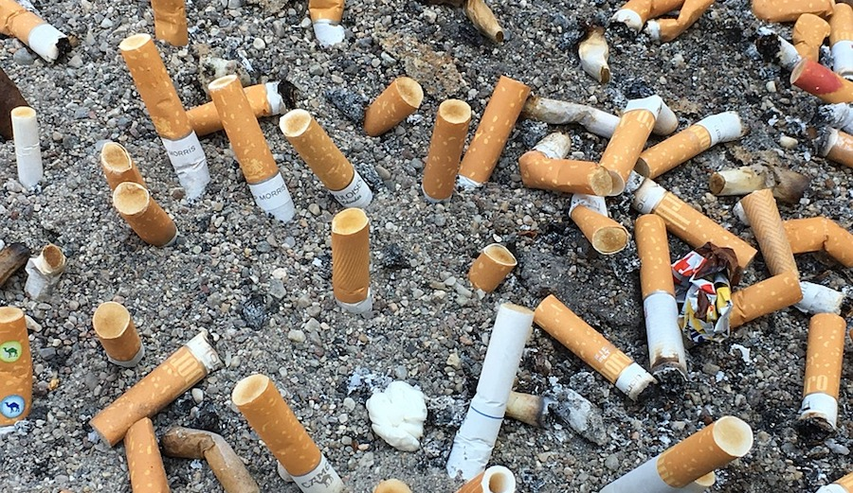
4 main programs
Great America Clean up
America Recycle Day
Retreet
Cigarette Litter Prevention Program

Slide 5
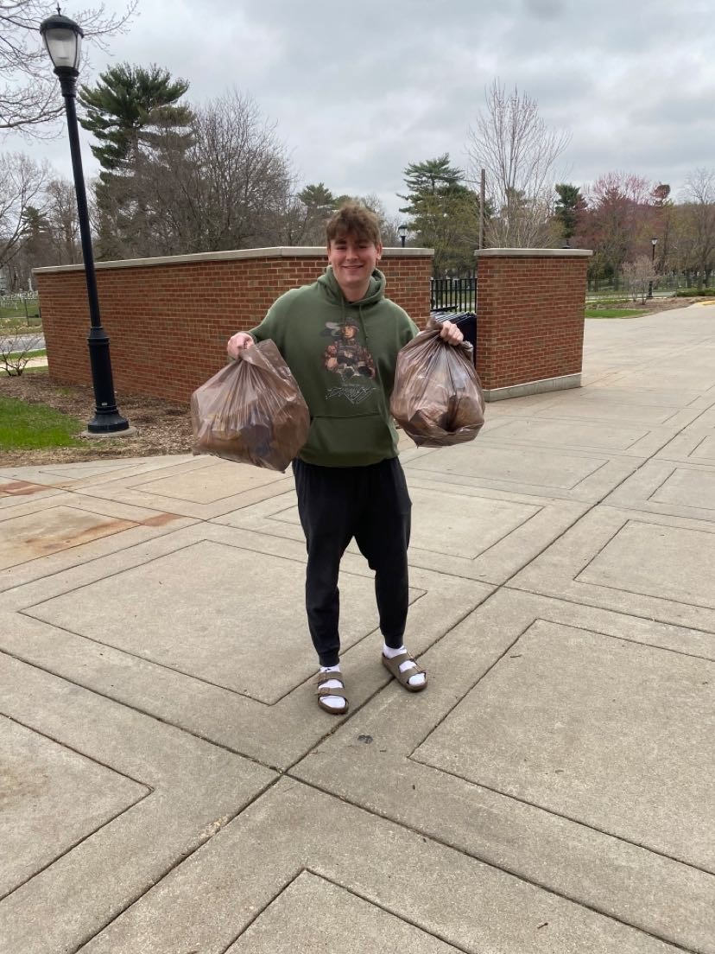

Slide 6
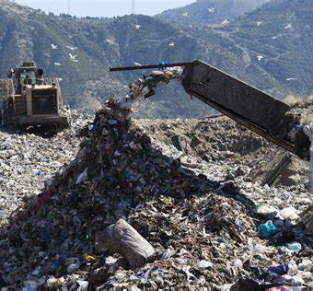
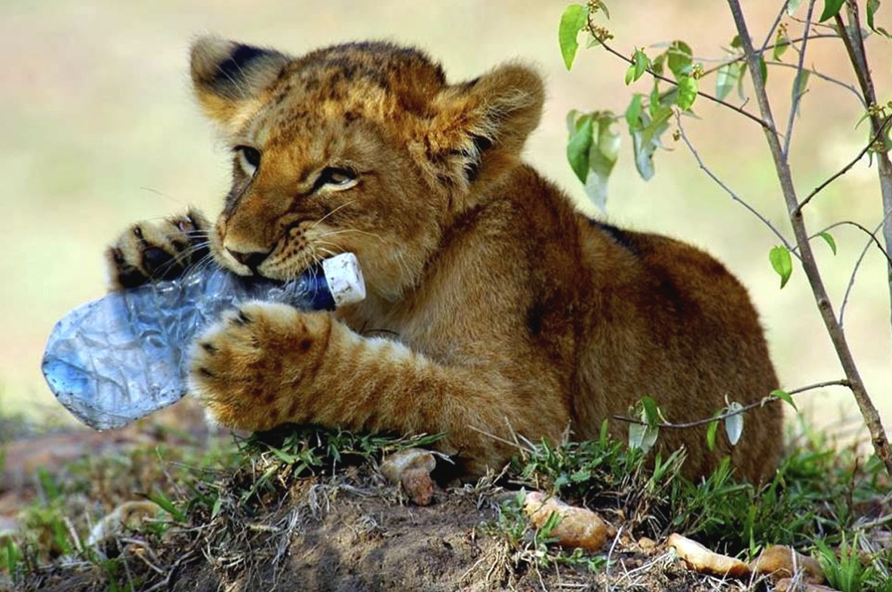
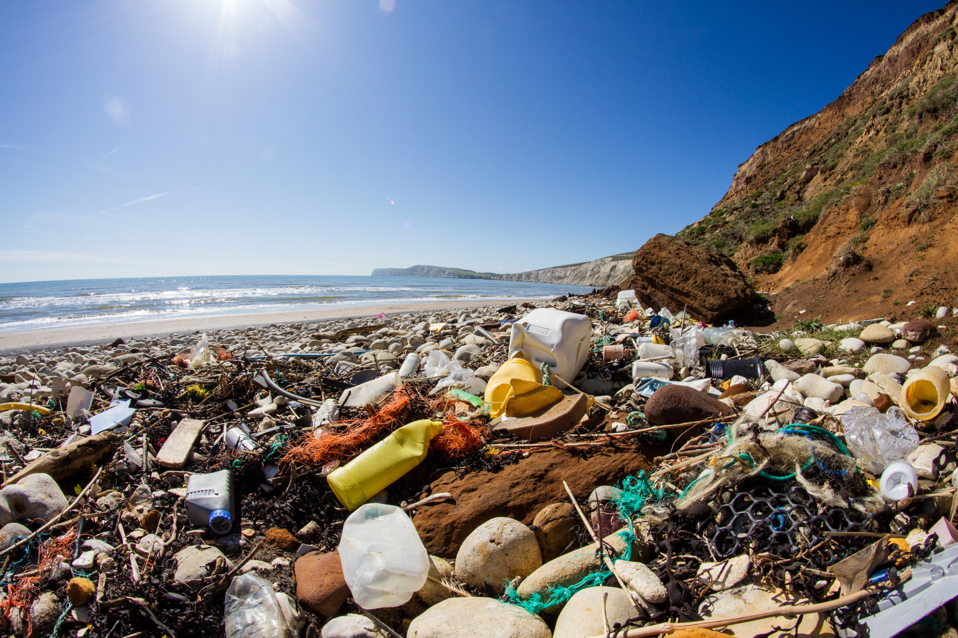

Slide 7
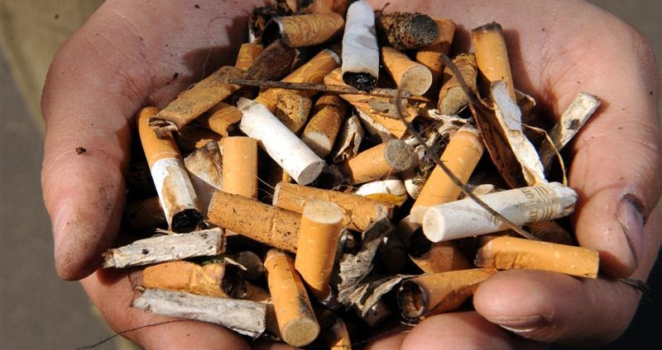
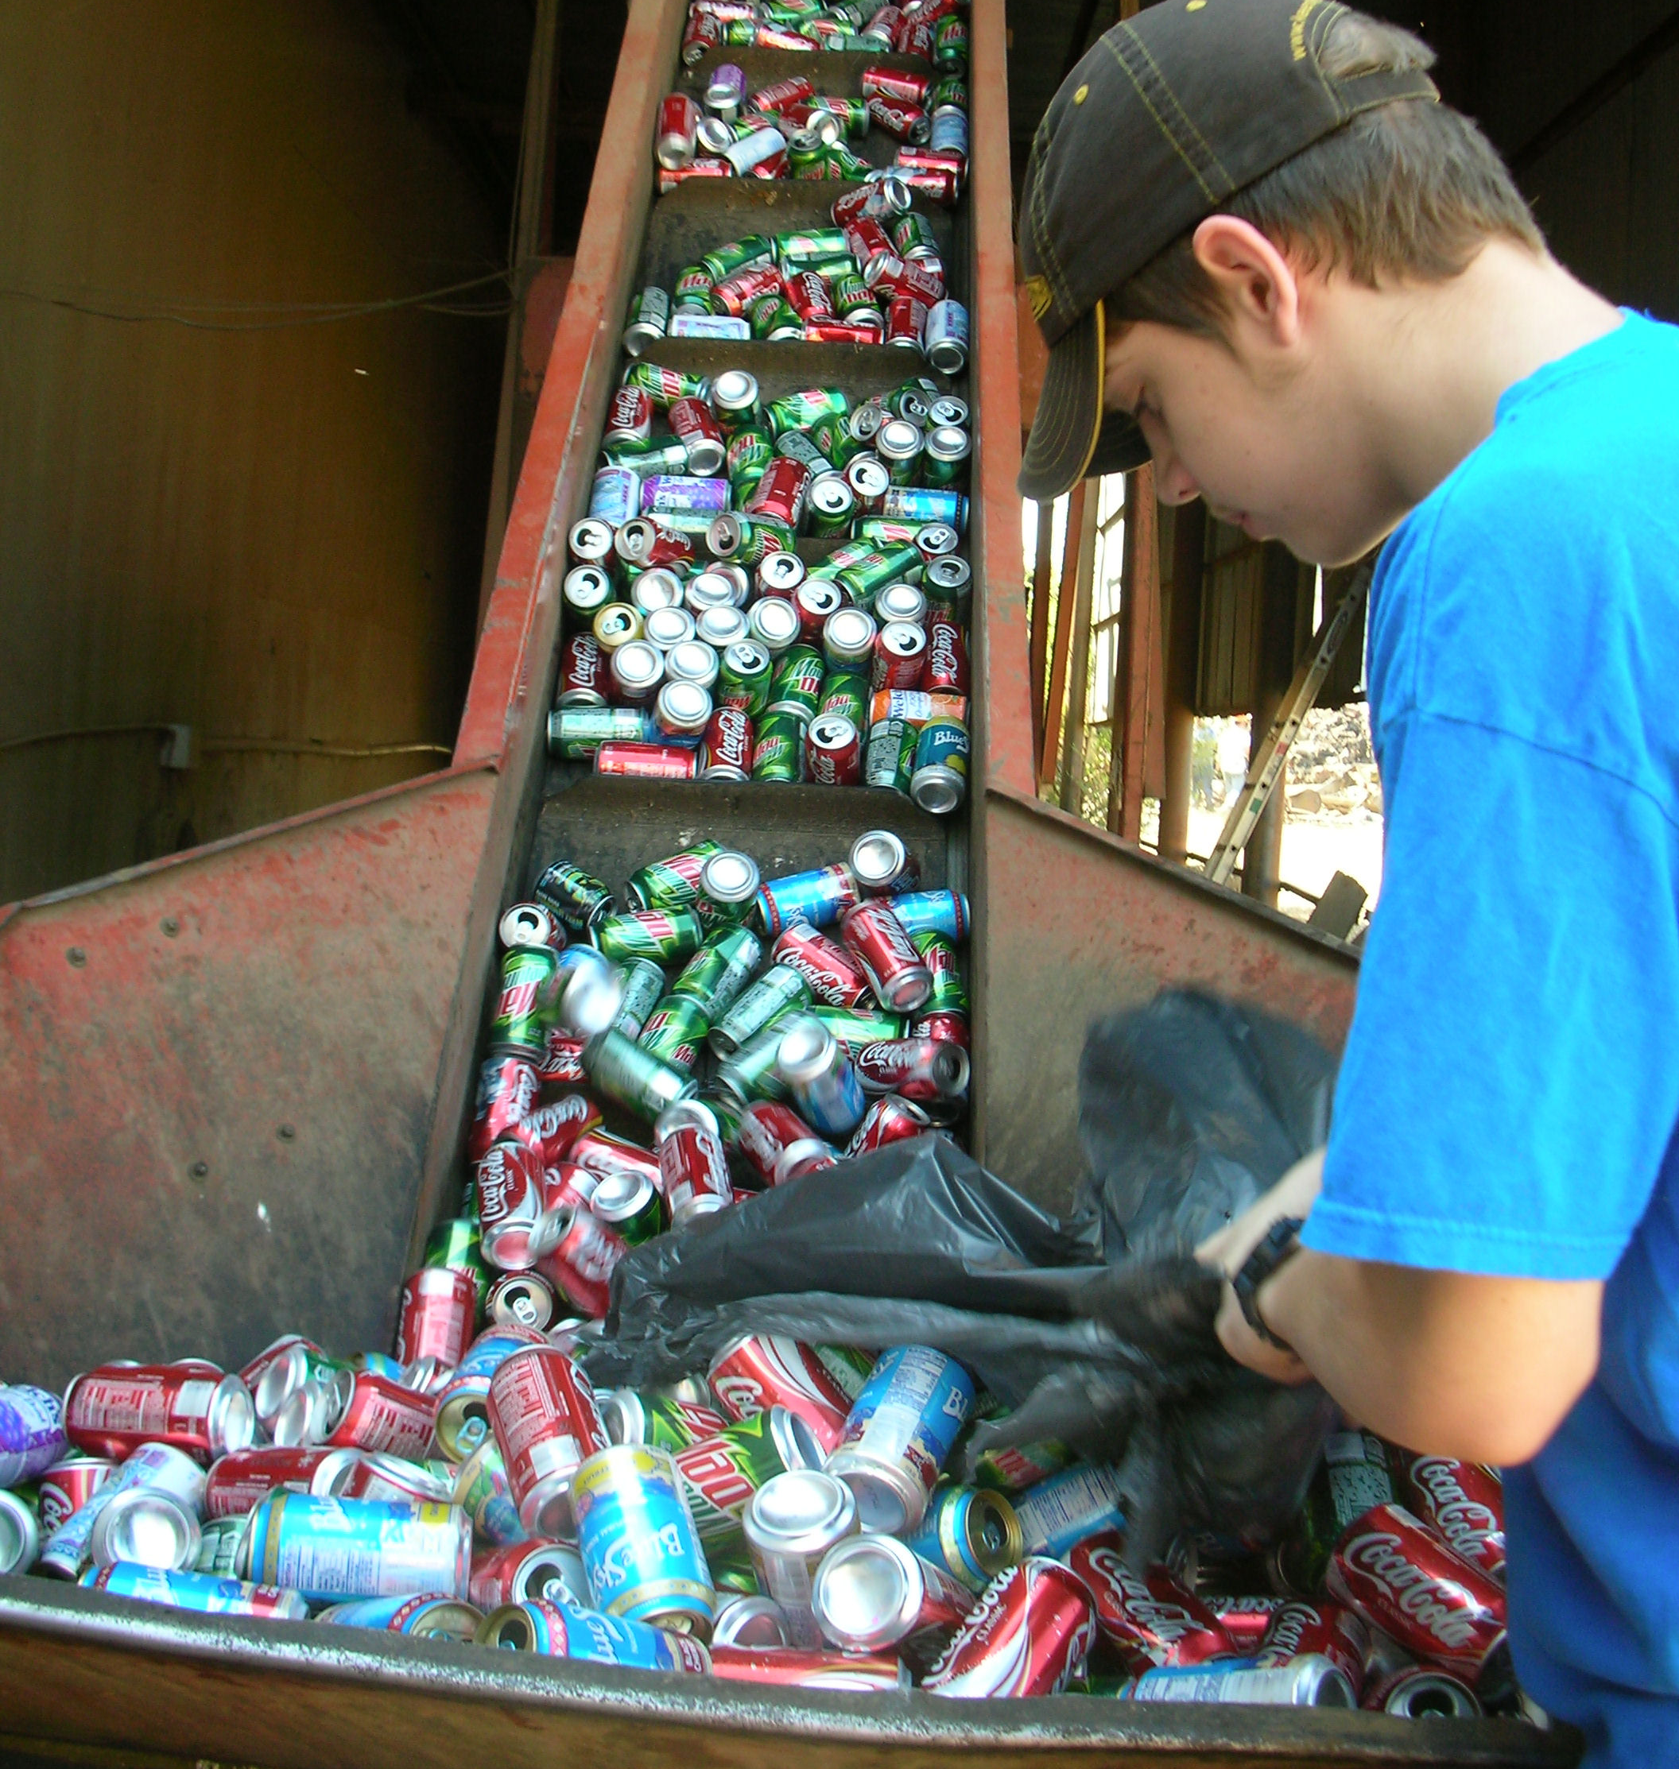

Slide 9
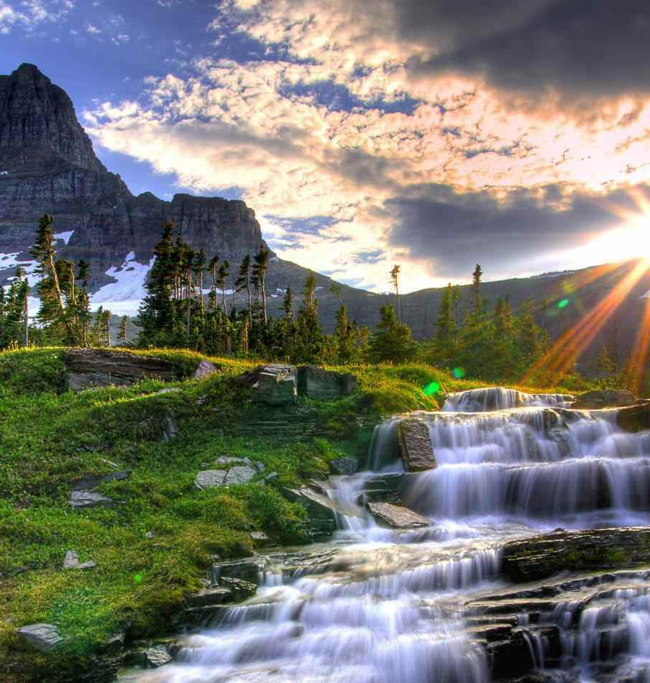
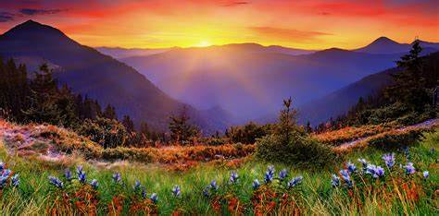

Slide 10
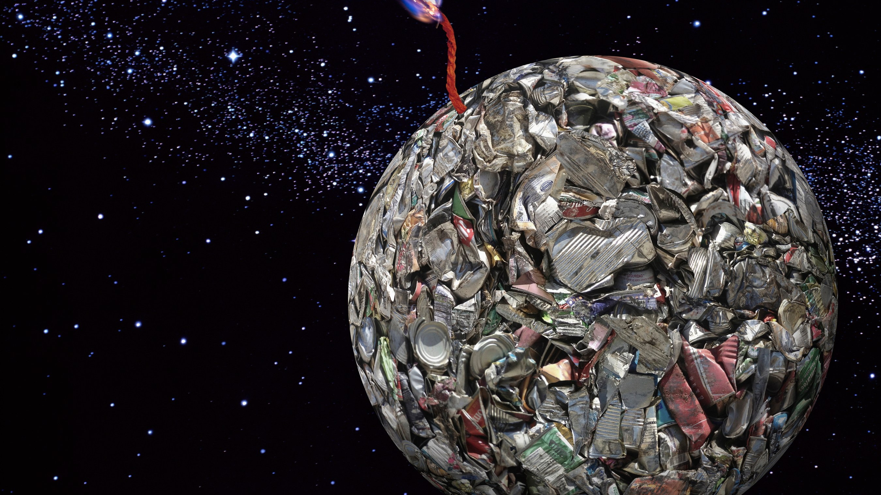

Slide 11
Thanks!

